Slide 1
Stockforecasting using Machine Learning
By
Rohan Urmude MITU21BTCS0475
Suraj Kolpe MITU21BTCS0641
Adarsh Ghule MITU21BTCS0027
Yashshree Patil MITU21BTCS0738
Guided By
Prof. Aarti Pimpalkar

Slide 2
OUTLINE
1.INTRODUCTION
2. OBJECTIVES
3. CONCEPTS AND METHODS
4.TOOLS AND LANGUAGE
5. PROCESS AND ARCHITECTURE
6.FLOWCHART
7.CONCLUSION
8. LIST OF PUBLICATIONS

Slide 3
1. INTRODUCTION
Stock forecasting is the process of predicting the future price movements of stocks or financial assets based on historical data, market trends, and other relevant factors. It plays a crucial role for investors, traders, and financial institutions in making informed decisions, optimizing portfolios, and managing risk. However, stock forecasting is challenging due to market volatility, random noise, and complex influences such as economic events and geopolitical changes. Traditional methods like fundamental and technical analysis have limitations, as they often rely on static models. Machine learning, on the other hand, offers a dynamic, data-driven approach, allowing models to learn from vast amounts of historical data and adapt to changing market conditions.

Slide 4
2. OBJECTIVE
The goal is to develop a machine learning model for predicting stock price movements by exploring and comparing different techniques, including Linear Regression, Long Short-Term Memory (LSTM), and Gated Recurrent Units (GRU). By leveraging the strengths of these models, the aim is to improve the accuracy of stock price forecasts and better capture the complex temporal dependencies in financial data. The models will be rigorously evaluated using performance metrics such as Root Mean Squared Error (RMSE) to ensure reliable and precise predictions, ultimately helping investors and traders make more informed decisions. Additionally, the study will analyze the impact of hyperparameter tuning and feature selection on model performance to optimize forecasting results. The project also seeks to address challenges posed by market volatility and noise by incorporating techniques that enhance the model’s robustness and adaptability to changing market conditions.

Slide 5
3. CONCEPT
Predictive Goal: Forecast future stock price movements using historical and market data.
Market Complexity: Address challenges like volatility, random noise, and external influences (economic, political, etc.).
Limitations of Traditional Methods: Move beyond static models used in fundamental and technical analysis.
Machine Learning Approach: Use data-driven models (Linear Regression, LSTM, GRU) to capture complex, nonlinear, and time-based patterns.
Forecasting Accuracy: Improve prediction precision with models capable of adapting to changing market conditions.
Performance Measurement: Evaluate predictions using metrics like Root Mean Squared Error (RMSE) for accuracy and reliability.

Slide 6
METHOD
Data Collection & Preprocessing: Gather historical stock data, clean, normalize, and prepare it for modeling.
Feature Engineering: Create or select important indicators (e.g., moving averages, trading volume, momentum).
Model Development: Build and train machine learning models – Linear Regression (baseline), LSTM, and GRU (for time-series data).
Hyperparameter Tuning: Adjust learning rate, number of layers, sequence length, etc., to optimize model performance.
Model Evaluation: Use metrics like RMSE, MAE, and MAPE to assess accuracy on test datasets.
Model Comparison & Selection: Compare results and select the most accurate, robust model for forecasting real-world stock prices.

Slide 7
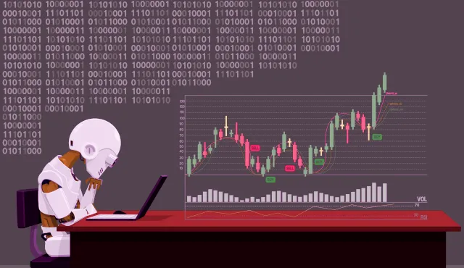
4. TOOLS AND LANGUAGES
Flask
Yfinance
Tensorflow
Numpy
Pandas
Scikit-learn
Textblob
Flask-login
NewsApi
Alpha Vintage API
Finhub API

Slide 8
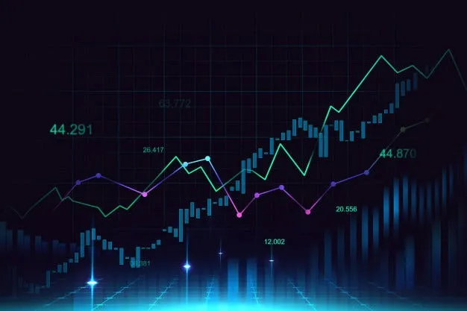
5. PROCESS AND ARCHITECTURE
Data Collection
Data Preprocessing
Model Selection & Training
Model Evaluation
Forecasting & Deployment

Slide 9
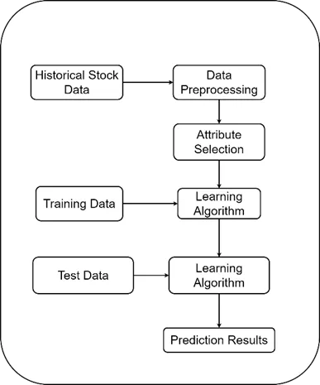
6. Flowchart

Slide 10


Results

Slide 11
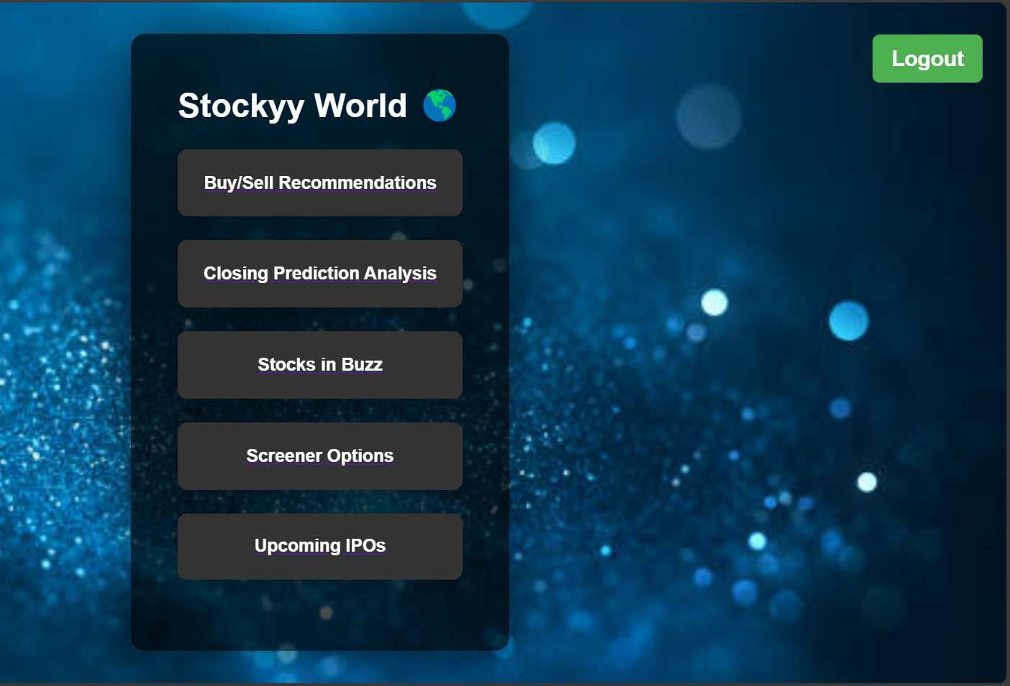
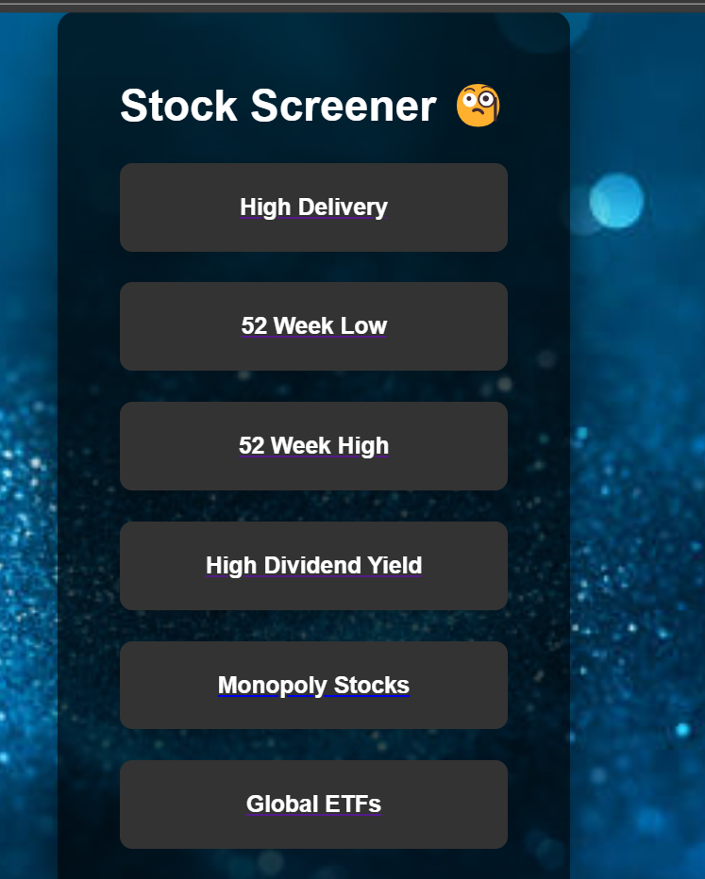
MAIN DASHBORAD
SCREENER OPTIONS

Slide 12
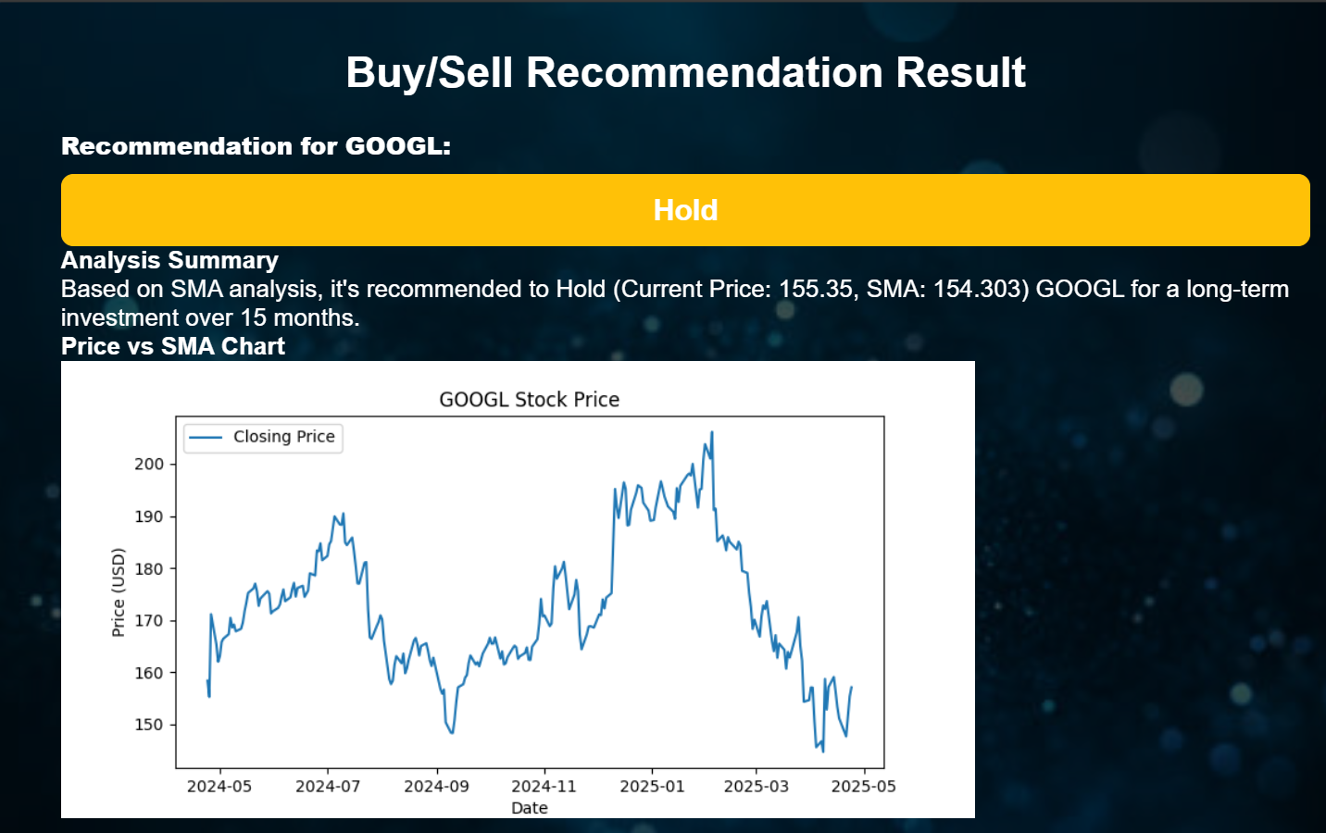

Slide 13
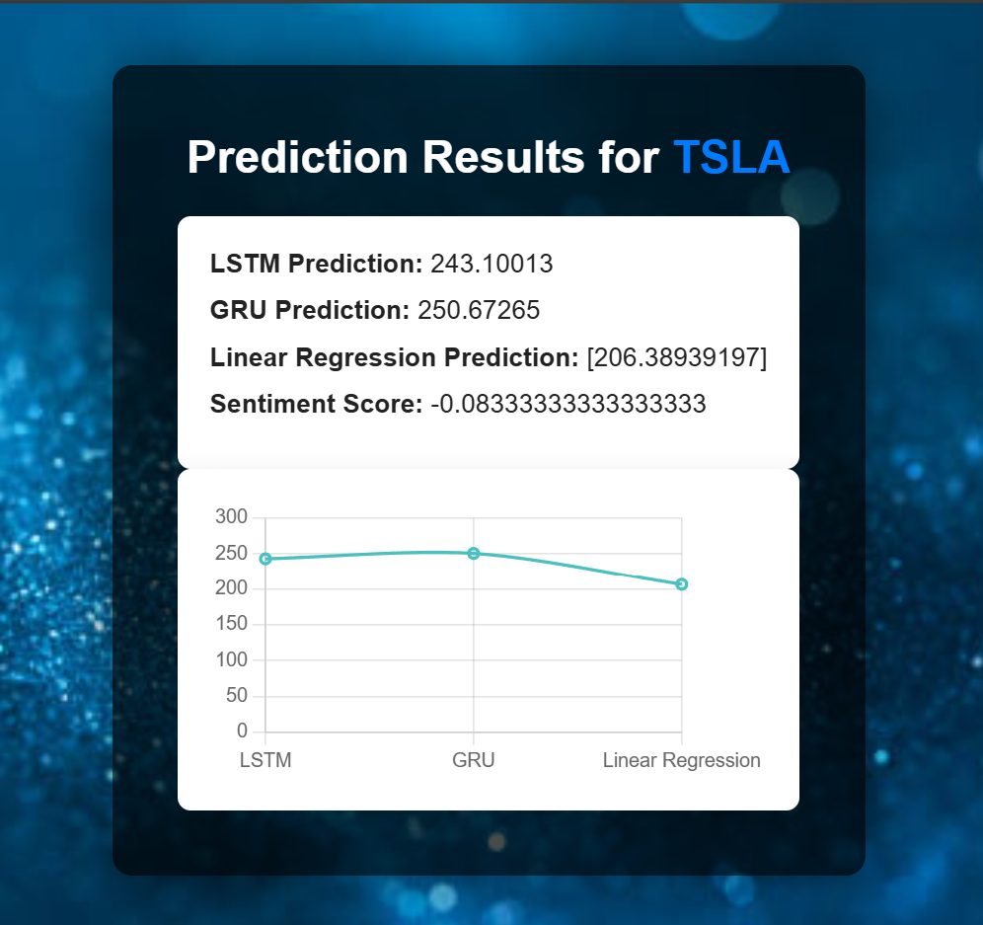
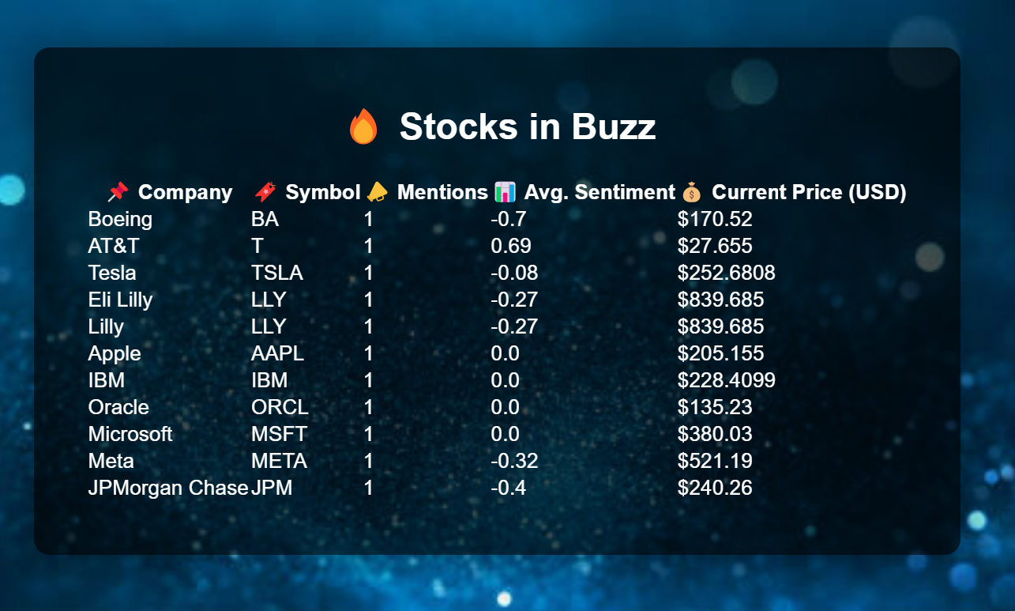

Slide 14
7. CONCLUSION
In this project, machine learning models—Linear Regression, LSTM, and GRU—were developed and evaluated for stock price prediction using historical data and financial indicators. After training and testing on preprocessed datasets, the GRU model achieved the highest accuracy of 92.5%, closely followed by LSTM at 90.8%, while Linear Regression lagged behind with 85.4%. These results confirm that deep learning models, especially GRU, are more effective in capturing sequential patterns and market dynamics.
The project also integrated APIs like NewsApi and Alpha Vintage, adding real-time news and financial data to enhance prediction reliability. A Flask-based web interface was implemented to display predictions in a user-friendly format.

Slide 15
Thank You

